Slide 1
Structure Programming
ICT-1105
Information and Communication Technology
Lecture-19
Date:

Slide 2
Class contents has given in Google Classroom with code
nhauiw4

Slide 3
Strings

Slide 4
String Concepts
A string is a series of characters treated as a single unit. A string may include letters, digits and various special characters such as +, -, *, / and $.
String literals or string constants in C are written in double quotation marks as follows:
“1000 Main Street” (a street address)
“080329-7082” (a telephone number)
“Cumilla” (a city).

Slide 5
String Concepts
String is an array of characters that is terminated by \0 (null character). This null character indicates the end of the string. Strings are always enclosed by double quotes ( “ “ ). Whereas, character is enclosed by single quotes.
or

Slide 6
String Concepts
In “C” language the group of characters, digits, and symbols enclosed within double quotation
( " " ) marks are called as string otherwise a string is an array of characters and terminated by NULL character which is denoted by the escape sequence “\0”.

Slide 7
String Concepts
In C language strings are stored in array of char type along with null terminating character ‘\0’
at the end.
When sizing the string array we need to add plus one to the actual size of the string to make space for the null terminating character, ‘\0’.

Slide 8
String Concepts
Declaration of String:
C does not support string as a data type. However, it allows us to represent strings as character arrays. In C, a string variable is any valid C variable name and it is always declared as an array of characters.

Slide 9
String Concepts
The general form of declaration of a string variable is :
Syntax: char string_name[size];
The size determines the number of characters in the string name.
Note: In declaration of string size must be required to mention otherwise it gives an error.

Slide 10
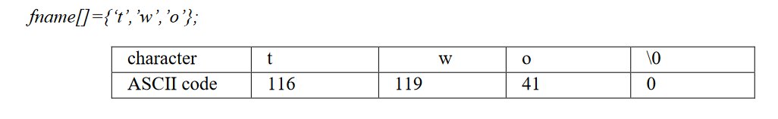
String Concepts
char fname[4];
The above statement declares a string called fname that can take up to 3 characters. It can be
indexed just as a regular array as well.

Slide 11
String Concepts
when we declare the string in this way, we can store size-1 characters in the array because the last character would be the null character.
For example,
char mesg[10];
can store maximum of 9 characters.

Slide 12
String Concepts
Note: In declaration of string size must be required to mention otherwise it gives an error.
Ex: char str[]; // Invalid
char str[0]; // Invalid
char str[-1]; // Invalid
char str[10]; // Valid
char a[9]; //Valid

Slide 13
String Concepts
A string is an array of characters. Hence it can be indexed like an array.
char ourstr[6] = “EED”;
– ourstr[0] is ‘E’
– ourstr[1] is ‘E’
– ourstr[2] is ‘D’
– ourstr[3] is ‘\0’
– ourstr[4] is ‘\0’
– ourstr[5] is ‘\0’

Slide 14
Initializing Array string
Syntax : char string_name[size]={“string” };
Note: In Initialization of the string if the specific number of character is not initialized it then rest of all character will be initialized with NULL.
Note: In initialization of the string we can not initialized more than size of string elements.
Ex:
char str[2]={'5','+','A','B'}; // Invalid

Slide 15
Initializing Array string
Different ways of initialization can be done in various ways :
1 : Initilizing locations character by character.
2 : Partial array initialization.
3 : Intilization without size.
4 : Array initialization with a string .

Slide 16
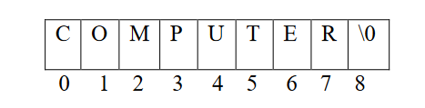
Initializing Array string
1 : Initializing locations character by character
Consider the following declaration with initialization,
Char b[9]={‘C’, ’O’, ’M’, ’P’,’U’, ’T’, ’E’, ’R’};
from 0 to 8 and these locations are initialized with the characters in the order specified. The remaining locations are automatically initialized to null characters.

Slide 17
Initializing Array string
2 : Partial Array Initilization :
If the characters to be initialized is less than the size of the array, then the characters are stored sequentially from left to right.The remaining locations will
be initialized to NULL characters automatically.

Slide 18
Initializing Array string
2 : Partial Array Initilization :
Ex : Consider the partial initilization
int a[10]={ ‘I’, ‘C’, ‘T’ };
The compiler allocates 10 bytes for the variable a ranging from 0 to 9 and initializes first four locations with the ASCII characters of ‘I’, ‘C’, ‘T’ . The remaining locations are automatically filled with NULL characters (i.e,\0).
I | C | T | \0 | \0 | \0 | \0 | \0 | \0 | \0
1 | 2 | 3 | 4 | 5 | 6 | 7 | 8 | 9 | 10

Slide 19
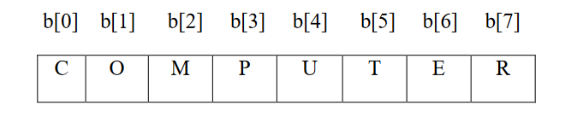
Initializing Array string
3 : Initialization without size :
consider the declaration along with the initialization
Char b[ ]={‘C’, ’O’, ’M’, ’P’,’U’, ’T’, ’E’, ’R’};
In this declaration, The compiler will set the array size to the total number of initial values i.e 8. The character will be stored in these memory locations in the order specified.

Slide 20
Initializing Array string
4) Array Initialization with a String :
Consider the declaration with string initialization.
char b[ ] = “COMPUTER”;
Here, the string length is 8 bytes. But , string size is 9 bytes. So the compiler reserves 8+1 memory locations and these locations are initialized with the characters in the order specified. The string is terminated by \0 by the compiler.

Slide 21
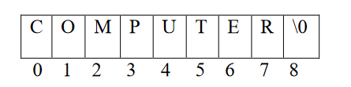
Initializing Array string
4) Array Initialization with a String :
The string “COMPUTER” contin 8 charactes, because it is a string. It always ends with null character. So, the array is 9 bytes (i.e string length+1 byte for null character).

Slide 22
Reading strings:
If we declare a string by writing
char str[100];
then str can be read from the user by using three ways;
1. Using scanf() function
2. Using gets() function
3. Using getchar(), getch(), or getche() function repeatedly

Slide 23
Reading strings:
The string can be read using scanf() by writing
scanf(“%s”, str);
Although the syntax of scanf() function is well known and easy to use, the main pitfall with this function is that it terminates as soon as it finds a blank space.
For example, if the user enters Hello World, then str will contain only Hello. This is because the moment a blank space is encountered, the string is terminated by the scanf() function.

Slide 24
Reading strings:
Example:
#include <stdio.h>
void main ()
{
char ch[13]={'c', 'p', 'r', 'o', 'g', 'r', 'a', 'm', 'm', ‘i', ‘n’, ‘g’, ‘\0’};
char ch2[13]="cprogramming";
printf("Char Array Value is: %s\n", ch);
printf("String Literal Value is: %s\n", ch2);
}
Output
Char Array Value is: cprogramming
String Literal Value is: cprogramming

Slide 25
Reading strings:
Example:
#include <stdio.h>
int main()
{
char name[20];
printf("Enter name: ");
scanf("%s", name);
printf("Your name is %s.", name);
return 0;
}
Output
Enter name: Dennis Ritchie
Your name is Dennis.

Slide 26
String Input/output Functions
The strings can be read from the keyboard and can be displayed onto the monitor using various functions.
The various input and output functions that are associated with can be classified as:

Slide 27
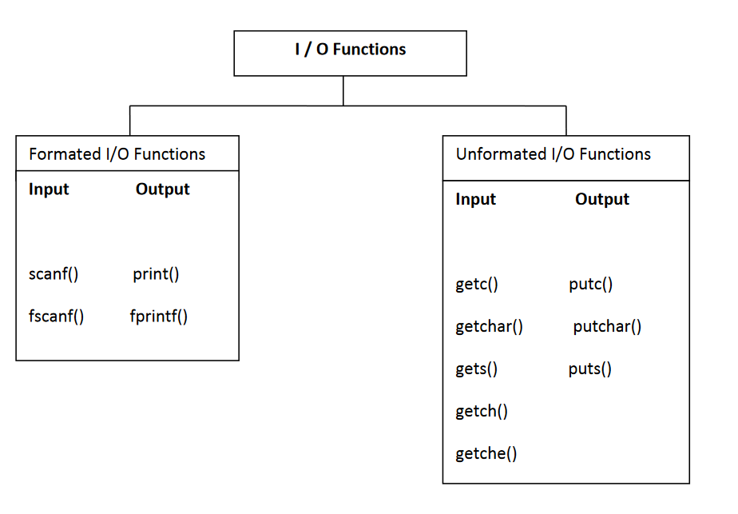
String Input/output Functions

Slide 28
Unformated I/O Functions
1 : getchar() function :
A single character can be given to the computer using ‘C’ input library function getchar().
Syntax : char variable=getchar();
The getchar() function is written in standared I/O library. It reads a single character from a standared input device. This function do not require any arguments, through a pair of parantheses, must follow the statements getchar().

Slide 29
Unformated I/O Functions
#include<stdio.h>
#include<conio.h>
#include<ctype.h>
void main()
{
char ch;
clrscr();
printf("Enter any character/digit:");
ch=getchar();
if(isalpha(ch)>0)
printf("it is a alphabet:%c\n",ch);
else if(isdigit(ch)>0)
printf("it is a digit:%c\n",ch);
else
printf("it is a alphanumeric:%c\n",ch);
getch();
}.
OUTPUT : Enter any character/Digit : a
it is a alphabet: a

Slide 30
Unformated I/O Functions
2 : putchar() function :
The putchar() function is used to display one character at a time on the standard output device. This function does the reverse operation of the single character input function.

Slide 31
Unformated I/O Functions
Syntax : putchar(character varaiable);
#include<stdio.h>
#include<conio.h>
#include<ctype.h>
void main()
{
char ch;
printf("Enter any alphabet either in lower or uppercase:");
ch=getchar();
if(islower(ch))
putchar(toupper(ch));
else
putchar(tolower(ch));
getch();
}
OUTPUT :Enter any alphabet either in lower or uppercase :a
A

Slide 32
Unformated I/O Functions
3 : gets() :
The gets() function is used to read the string (String is a group of characters) from the standard input device (keyboard).
Syntax : gets(char type of array variable);
Example:
char str[10];
printf(“Enter a string\n”);
gets(str);

Slide 33
Unformated I/O Functions
gets() is a function that overcomes the drawbacks of scanf(). The gets() function takes the starting address of the string which will hold the input. The string inputted using gets() is automatically terminated with a null character.

Slide 34
Unformated I/O Functions
gets() is a function that overcomes the drawbacks of scanf(). The gets() function takes the starting address of the string which will hold the input. The string inputted using gets() is automatically terminated with a null character.

Slide 35
Unformated I/O Functions
The string can also be read by calling the getchar() repeatedly to read a sequence of single characters (unless a terminating character is encountered) and simultaneously storing it in a character array as follows:

Slide 36
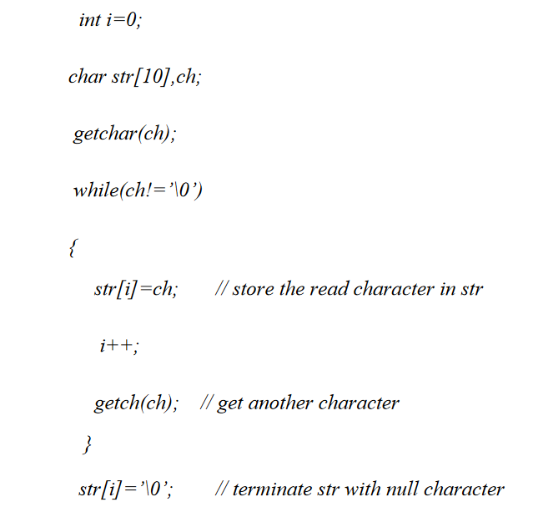
Unformated I/O Functions

Slide 37
Unformated I/O Functions
Ex :
#include<stdio.h>
#include<conio.h>
void main()
{
char str[40];
clrscr();
printf("Enter String name:");
gets(str);
printf("Print the string name%s:",str);
getch();
}
OUTPUT : Enter the string : reddy
Print the string :reddy

Slide 38
Unformated I/O Functions
Ex :
#include<stdio.h>
#include<conio.h>
void main()
{
char str[40];
clrscr();
printf("Enter String name:");
gets(str);
printf("Print the string name%s:",str);
getch();
}
OUTPUT : Enter the string : reddy
Print the string :reddy

Slide 39
Unformated I/O Functions
The string can be displayed on screen using three ways:
1. Using printf() function
2. Using puts() function
3. Using putchar() function repeatedly
The string can be displayed using pintf() by writing printf(“%s”,str);

Slide 40
Unformated I/O Functions
The string can be displayed on screen using three ways:
1. Using printf() function
2. Using puts() function
3. Using putchar() function repeatedly
The string can be displayed using pintf() by writing printf(“%s”,str);

Slide 41
Unformated I/O Functions
We can use width and precision specification along with %s. The width specifies the minimum output field width and the precision specifies the maximum number of characters to be displayed.
Example:
printf(“ %5.3s ”, str);
this statement would print only the first three characters in a total field of five characters; also these three characters are right justified in the allocated width.

Slide 42
Unformated I/O Functions
The next method of writing a string is by using the puts() function. The string can be displayed by writing:
puts(char type of array variable);
It terminates the line with a newline character (‘\n’). It returns an EOF(-1) if an error occurs and
returns a positive number on success.

Slide 43
Unformated I/O Functions
Program using gets() function and puts() function.
#include<stdio.h>
#include<conio.h>
void main()
{
char str[40];
puts("Enter String name:");
gets(str);
puts("Print the string name:");
puts(str);
getch();
}

Slide 44
Unformated I/O Functions
getch() function :The getch function reads a single character directly from the keyboard, without echoing to the screen.
Syntax : int getch();
Ex : #include<stdio.h>
void main()
{
char c;
c=getch();
}

Slide 45
Unformated I/O Functions
getche() function :The getche() function reads a single character from the keyboard and echoes it to the current text window.
Syntax : int getche();
Ex : #include<stdio.h>
void main()
{
char c;
c=getche();
}

Slide 46
Unformated I/O Functions
getc() function : This function is used to accept a single character from the standared input to a
character variable.
Syntax : character variable=getc();
putc() function :This function is used to display a single character in a character variable to standared output device.
Syntax : putc(character variable);

Slide 47
Unformated I/O Functions
Finally the string can be written by calling the putchar( ) function repeatedly to print a sequence
of single characters.
int i=0;
char str[10];
while(str[i]!=’\0’)
{
putchar(str[i]); // print the character on the screen
i++;
}

Slide 48
String Manipulation Functions/ String Handling Functions
The various string handling functions that are supported in C language are as shown
All these functions are defined in string.h header file.
Type | Method | Description
char | strcpy(s1, s2) | Copy string
char | strcat(s1, s2) | Append string
int | strcmp(s1, s2) | Compare 2 strings
int | strlen(s) | Return string length
char | strlwr(str) | Converts the string str to lowercase
char | strupr(str) | Converts the string str to uppercase.
char | strrev(str) | Reverse the string str.
char | strchr(s, int c) | Find a character in string
char | strstr(s1, s2) | Find string s2 in string s1

Slide 49
strcpy()
It is used to copy one string to another string. The content of the second string is copied to the content of the first string.
Syntax: strcpy (string 1, string 2);
Where
string1 : is the destination string.
string 2: is the source string.
i.e the contents of string2 is assigned to the contents of string1

Slide 50
strcpy()
Ex : Progrm using strcpy() function
#include<stdio.h>
#include<conio.h>
#include<string.h>
void main()
{
char str1[]=“CODING";
char str2[10];
strcpy(str2,str1);
printf("The string1 is :%s\n",str1);
printf("The string2 is :%s\n",str2);
strcpy(str2,str1+1);
printf("The string1 is :%s\n",str1);
printf("The string2 is :%s",str2);
}

Slide 51
strcpy()
OUTPUT :
The string1 is : CODING
The string2 is : CODING
The string1 is : CODING
The string2 is : ODING

Slide 52
strcpy()
Write a program to copy contents of one string to another string.
#include<stdio.h>
#include<conio.h>
void main()
{
char str1[10],str2[20];
int index;
printf("Enter the string\n");
scanf(“%s”,str1);
for(index=0;str1[index]!='\0';index++)
str2[index]=str1[index];
str2[index]='\0';
printf("String1 is :%s\n",str1);
printf("String2 is :%s\n",str2);
getch();
}

Slide 53
strcpy()
OUTPUT :
Enter the string : cprogramming
String1 is : cprogramming
String2 is : cprogramming

Slide 54
strcmp()
String Comparision :This function is used to compares two strings to find out whether they are same or different. If two strings are compared character by character until the end of one of the string is reached. If the two strings are same strcmp() returns a value zero. If they are not equal, it returns the numeric difference between the first non-matching characters.
Syntax : strcmp(string1,string2);

Slide 55
strcmp()
Program using strcmp() function
#include<stdio.h>
#include<conio.h>
#include<string.h>
void main()
{
char str1[]="reddy";
char str2[]="reddy";
int i,j,k;
i=strcmp(str1,str2);
j=strcmp(str1,"subba");
k=strcmp(str2,"Subba");
printf("%5d%5d%5d\n",i,j,k);
}
OUTPUT : 0 -1 32

Slide 56
strcmp()
Write a C program to find the comparision of two strings.
#include<stdio.h>
#include<conio.h>
#include<string.h>
void main()
{
char str1[10],str2[20];
int index,l1,l2,flag=1;
printf("Enter first string:");
scanf("%s",str1);
printf("Enter second string:");
scanf("%s",str2);
l1=strlen(str1);
l2=strlen(str2);
printf("Length of string1:%d\n",l1);
printf("Length of string2:%d\n",l2);

Slide 57
strcmp()
if(l1==l2)
{
for(index=0;str1[index]!='\0';index++)
{
if(str1[index]!=str2[index])
{
flag=0;
break;
}
}
}
else
  flag=0;
if(flag==1)
printf("Strings are equal");
else
printf("Strings are not equal");
}

Slide 58
strcmp()
OUTPUT : Enter the first string :jbrec
Enter the second string:jbrec
Length of string1 :5
Length of string2 :5
Strings are equal

Slide 59
strcat()
String Concatenation : This function is used to concatenate or combine, two strings together and forms a new concatenated string.
Syntax : strcat(sting1,string2);
Where
string1 : is the first string1.
string2 : is the second string2
when the above function is executed, string2 is combined with string1 and it removes the null character (\0) of string1 and places string2 from there.

Slide 60
strcat()
Program using strcat() function.
#include<stdio.h>
#include<conio.h>
#include<string.h>
void main()
{
char str1[10]="ICT";
char str2[]="Department";
printf("%s\n",str1);
printf("%s\n",str2);
printf("%s\n",strcat(str1,str2));
getch();
}
OUTPUT :
ICT
Department
ICTDepartment

Slide 61
strlen()
String Length : This function is used to count and return the number of characters present in a string.
Syntax : var=strlen(string);

Slide 62
strlen()
Ex : Progrm using strlen() function
#include<stdio.h>
#include<conio.h>
#include<string.h>
void main()
{
char name[]=“ICT";
int len1,len2;
clrscr();
len1=strlen(name);
len2=strlen(“BANGLADESH");
printf("The string length of %s is: %d\n",name,len1);
printf("The string length of %s is: %d"," BANGLADESH",len2);
getch();
}
OUTPUT :
The string length of ICT is : 3
The string length of BANGLADESH : 10

Slide 63
strllwr()
String LowerCase : This function is used to converts upper case letters of the string in to lower case letters.
Syntax : strlwr(string);

Slide 64
strllwr()
#include<stdio.h>
#include<conio.h>
#include<string.h>
void main()
{
char str[]=“ICT";
clrscr();
strlwr(str);
printf("The lowercase is :%s\n",str);
getch();
}
OUTPUT : The lowercase is : ict

Slide 65
strllwr()
Write a program to which converts given string in to lowercase.
#include<stdio.h>
#include<conio.h>
void main()
{
char str[10];
int index;
printf("Enter the string:");
scanf("%s",str);

Slide 66
strllwr()
for(index=0;str[index]!='\0';index++)
{
if(str[index]>='A' && str[index]<='Z')
str[index]=str[index]+32;
}
printf("After conversionis :%s",str);
getch();
}
OUTPUT :
Enter the string : BANGLADESH
After conversion string is :bangladesh

Slide 67
strupr()
String UpperCase : This function is used to converts lower case letters of the string in to upper case letters.
Syntax : strupr(string);

Slide 68
strupr()
Program using strupr() function.
#include<stdio.h>
#include<conio.h>
#include<string.h>
void main()
{
char str[]=“ict";
strupr(str);
printf("UpperCase is :%s\n",str);
getch();
}
OUTPUT
UpperCase is : ICT

Slide 69
strupr()
Write a program to which converts given string in to uppercase.
#include<stdio.h>
#include<conio.h>
void main()
{
char str[10];
int index;
printf("Enter the string:");
scanf("%s",str);
for(index=0;str[index]!='\0';index++)
{
if(str[index]>='a' && str[index]<='z')
str[index]=str[index]-32;
}
printf("After conversionis :%s",str);
getch();
}
OUTPUT : Enter the string : technology
After conversion string is : TECHNOLOGY

Slide 70
strrev()
String Reverse :This function is used to reverse a string. This function takes only one argument and return one argument.
Syntax : strrev(string);

Slide 71
strrev()
Ex : Program using strrev() function
#include<stdio.h>
#include<conio.h>
#include<string.h>
void main()
{
char str[20];
printf("Enter the string:");
scanf("%s",str);
printf("The string reversed is:%s",strrev(str));
getch();
}
OUTPUT : Enter the string :university
The string reversed is : ytisrevinu

Slide 72
strchr()
It is used to find a character in the string and returns the index of occurrence of the character for the first time in the string.
Syntax: strchr(cstr);
Example:
char mystr[] = "This is a simple string";
char pch = strchr(mystr, ‘s’);
The output of pch is mystr[3]

Slide 73
strstr()
It is used to return the existence of one string inside another string and it results the starting index of the string.
Syntax: strstr(cstr1, cstr2);
Example:
Char mystr[]="This is a simple string";
char pch = strstr(mystr, “simple”);
here pch will point to mystr[10]

Slide 74
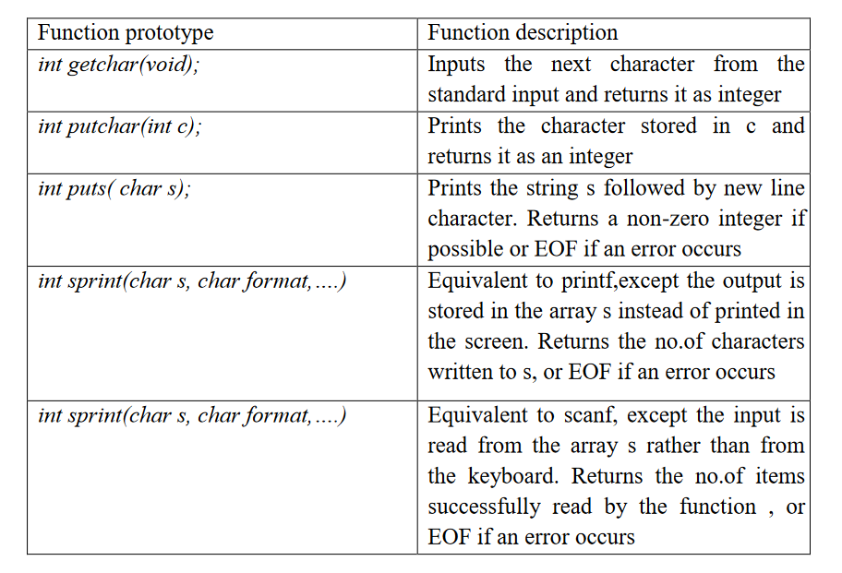
String input/output library functions

Slide 75
Thank you….

